Slide 1









pLUTo
Enabling Massively Parallel Computation in DRAM via Lookup Tables
João Dinis Ferreira |  | Gabriel Falcao |  | Juan Gómez-Luna |  | Mohammed Alser
Lois Orosa |  | Mohammad Sadrosadati |  | Jeremie S. Kim |  | Geraldo F. Oliveira
Taha Shahroodi |  | Anant Nori |  | Onur Mutlu

Slide 2
Summary
Background: Processing-in-Memory (PiM) alleviates the performance and energy bottlenecks caused by data movement in modern applications
Processing-near-Memory (PnM): adds logic elements near memory arrays
Processing-using-Memory (PuM): uses the analog properties of memory for computation
Problem: Existing Processing-using-DRAM architectures only support a limited range of operations (data movement, bitwise logic, bit shifting)
This limits Processing-using-DRAM’s applicability to a narrow set of applications
Goal: Extend the applicability of Processing-using-DRAM by designing a PuM substrate with support for complex operations
pLUTo: A Processing-using-DRAM substrate that replaces complex operations with equivalent memory lookups
pLUTo LUT Query operation enables bulk in-memory table lookups
Three pLUTo designs target different performance/energy/area tradeoffs
pLUTo API and pLUTo Compiler facilitate programmer adoption
Key Results: Our extensive evaluation shows that pLUTo
Greatly outperforms CPU/GPU/PnM baselines, both in performance and energy
Incurs small DRAM area overheads (between 10.2% and 23.1%)
https://github.com/CMU-SAFARI/pLUTo

Slide 3
Contents
Introduction
pLUTo
Overview
pLUTo Designs
System Integration
Evaluation
Conclusion

Slide 4
Contents
Introduction
pLUTo
Overview
pLUTo Designs
System Integration
Evaluation
Conclusion

Slide 5

Data Movement Bottleneck
Data movement is a major bottleneck in modern computer architectures
Computing Unit
(CPU, GPU, FPGA, Accelerators)
Main Memory
Memory
Channel

Slide 6
Data Movement Bottleneck
Data movement is a major bottleneck in modern computer architectures
Computing Unit
(CPU, GPU, FPGA, Accelerators)
Main Memory
bandwidth-limited
Memory
Channel
power-hungry

Slide 7
Data Movement Bottleneck
Data movement is a major bottleneck in modern computer architectures
Computing Unit
(CPU, GPU, FPGA, Accelerators)
Main Memory
bandwidth-limited
Memory
Channel
power-hungry
Over 60% of the total system energy is spent on data movement¹
¹ A. Boroumand et al., “Google Workloads for Consumer Devices: Mitigating Data Movement Bottlenecks,” ASPLOS, 2018

Slide 8
Processing-in-Memory
1. Processing-near-Memory
Main Memory
Computing Unit
(CPU, GPU, FPGA, Accelerators)
Memory
Channel
Processing-near-Memory leverages additional logic placed on the same die as memory or on the logic layer of 3D-stacked memory

Slide 9
Processing-in-Memory
2. Processing-using-Memory
Computing Unit
(CPU, GPU, FPGA, Accelerators)
Main Memory
Memory
Channel
Processing-using-Memory leverages the operational principles of memory to perform computation

Slide 10
Limitations of Processing-using-DRAM
Data Movement | RowClone, Seshadri+ 2013 LISA, Chang+ 2013
Bitwise Operations | Ambit, Seshadri+ 2017
Bit Shifting | DRISA, Li+ 2017
Arithmetic Operations | SIMDRAM, Hajinazar & Oliveira+ 2021
Existing Processing-using-DRAM architectures only support a limited range of operations

Slide 11
The Goal of pLUTo
Extend Processing-using-DRAM to support the execution of arbitrarily complex operations

Slide 12
Contents
Introduction
pLUTo
Overview
pLUTo Designs
System Integration
Evaluation
Conclusion

Slide 13

pLUTo: Key Idea
x
x
ALU
?
x
input
output

Slide 14
pLUTo: Key Idea
x
ALU
?
x
f(x)
x
input
output

Slide 15
pLUTo: Key Idea
x
?
ALU
f(x)
x
x
input
output

Slide 16

pLUTo: Key Idea
x
ALU
f(x)
x
x
input
output
x
?
input
output

Slide 17
pLUTo: Key Idea
x
ALU
f(x)
x
x
input
output
x
x
?
input
output

Slide 18
pLUTo: Key Idea
x
ALU
f(x)
x
x
input
output
x
x
LUT[x]
?
input
output

Slide 19
pLUTo: Key Idea
x
ALU
f(x)
x
x
input
output
Replace computation with memory accesses
→ pLUTo LUT Query operation
x
LUT[x]
input
output

Slide 20
The pLUTo LUT Query: Setup
Desired LUT Query
Return {2nd, 1st, 2nd, 4th} prime numbers
{2nd, 1st, 2nd, 4th}

Slide 21
The pLUTo LUT Query: Setup
Desired LUT Query
Return {2nd, 1st, 2nd, 4th} prime numbers
{2nd, 1st, 2nd, 4th}
input vector

Slide 22
The pLUTo LUT Query: Setup
Desired LUT Query
Return {2nd, 1st, 2nd, 4th} prime numbers
{2nd, 1st, 2nd, 4th}
LUT index
0
1
2
3
Prime numbers | A
i | f(i)
1st | 2
2nd | 3
3rd | 5
4th | 7
input vector
lookup table

Slide 23
The pLUTo LUT Query: Setup
Desired LUT Query
Return {2nd, 1st, 2nd, 4th} prime numbers
{2nd, 1st, 2nd, 4th}
LUT index
0
1
2
3
Prime numbers | A
i | f(i)
1st | 2
2nd | 3
3rd | 5
4th | 7
1
input vector
lookup table

Slide 24
The pLUTo LUT Query: Setup
Desired LUT Query
Return {2nd, 1st, 2nd, 4th} prime numbers
{2nd, 1st, 2nd, 4th}
LUT index
0
1
2
3
Prime numbers | A
i | f(i)
1st | 2
2nd | 3
3rd | 5
4th | 7
1 | 0
input vector
lookup table

Slide 25
The pLUTo LUT Query: Setup
Desired LUT Query
Return {2nd, 1st, 2nd, 4th} prime numbers
{2nd, 1st, 2nd, 4th}
LUT index
0
1
2
3
Prime numbers | A
i | f(i)
1st | 2
2nd | 3
3rd | 5
4th | 7
1 | 0 | 1
input vector
lookup table

Slide 26
The pLUTo LUT Query: Setup
Desired LUT Query
Return {2nd, 1st, 2nd, 4th} prime numbers
{2nd, 1st, 2nd, 4th}
LUT index
0
1
2
3
Prime numbers | A
i | f(i)
1st | 2
2nd | 3
3rd | 5
4th | 7
1 | 0 | 1 | 3
input vector
lookup table

Slide 27
The pLUTo LUT Query: Setup
Desired LUT Query
Return {2nd, 1st, 2nd, 4th} prime numbers
{2nd, 1st, 2nd, 4th}
LUT index
0
1
2
3
Prime numbers | A
i | f(i)
1st | 2
2nd | 3
3rd | 5
4th | 7
1 | 0 | 1 | 3
output vector
input vector
lookup table

Slide 28
The pLUTo LUT Query: Setup
Desired LUT Query
Return {2nd, 1st, 2nd, 4th} prime numbers
{2nd, 1st, 2nd, 4th}
LUT index
0
1
2
3
Prime numbers | A
i | f(i)
1st | 2
2nd | 3
3rd | 5
4th | 7
1 | 0 | 1 | 3
output vector
input vector
lookup table

Slide 29
The pLUTo LUT Query: Setup
Desired LUT Query
Return {2nd, 1st, 2nd, 4th} prime numbers
{2nd, 1st, 2nd, 4th}
LUT index
0
1
2
3
Prime numbers | A
i | f(i)
1st | 2
2nd | 3
3rd | 5
4th | 7
1 | 0 | 1 | 3
in-memory
lookup table
output vector
input vector
lookup table

Slide 30
The pLUTo LUT Query: Setup
Desired LUT Query
Return {2nd, 1st, 2nd, 4th} prime numbers
LUT index
0
1
2
3
{2nd, 1st, 2nd, 4th}
Prime numbers | A
i | f(i)
1st | 2
2nd | 3
3rd | 5
4th | 7
1st
2nd
3rd
4th
1 | 0 | 1 | 3
output vector
3
input vector
3
in-memory
lookup table

Slide 31
The pLUTo LUT Query: Operation
Desired LUT Query
Return {2nd, 1st, 2nd, 4th} prime numbers
LUT index
0
1
2
3
{2nd, 1st, 2nd, 4th}
Prime numbers | A
i | f(i)
1st | 2
2nd | 3
3rd | 5
4th | 7
1st
2nd
3rd
4th
1 | 0 | 1 | 3
output vector
3
input vector
3
in-memory
lookup table

Slide 32
The pLUTo LUT Query: Operation
Desired LUT Query
Return {2nd, 1st, 2nd, 4th} prime numbers
LUT index
0
1
2
3
{2nd, 1st, 2nd, 4th}
Prime numbers | A
i | f(i)
1st | 2
2nd | 3
3rd | 5
4th | 7
1st
2nd
3rd
4th
3
1 | 0 | 1 | 3
output vector
input vector
in-memory
lookup table

Slide 33
The pLUTo LUT Query: Operation
Desired LUT Query
Return {2nd, 1st, 2nd, 4th} prime numbers
LUT index
0
1
2
3
{2nd, 1st, 2nd, 4th}
Prime numbers | A
i | f(i)
1st | 2
2nd | 3
3rd | 5
4th | 7
1st
2nd
3rd
4th
3
1 | 0 | 1 | 3
2
2
output vector
input vector
in-memory
lookup table

Slide 34
The pLUTo LUT Query: Operation
Desired LUT Query
Return {2nd, 1st, 2nd, 4th} prime numbers
LUT index
0
1
2
3
{2nd, 1st, 2nd, 4th}
Prime numbers | A
i | f(i)
1st | 2
2nd | 3
3rd | 5
4th | 7
1st
2nd
3rd
4th
3
2
1 | 0 | 1 | 3
output vector
input vector
in-memory
lookup table

Slide 35
The pLUTo LUT Query: Operation
Desired LUT Query
Return {2nd, 1st, 2nd, 4th} prime numbers
LUT index
0
1
2
3
{2nd, 1st, 2nd, 4th}
Prime numbers | A
i | f(i)
1st | 2
2nd | 3
3rd | 5
4th | 7
1st
2nd
3rd
4th
3 | 2
1 | 0 | 1 | 3
output vector
3
input vector
3
in-memory
lookup table

Slide 36
The pLUTo LUT Query: Operation
Desired LUT Query
Return {2nd, 1st, 2nd, 4th} prime numbers
LUT index
0
1
2
3
{2nd, 1st, 2nd, 4th}
Prime numbers | A
i | f(i)
1st | 2
2nd | 3
3rd | 5
4th | 7
1st
2nd
3rd
4th
3
3 | 2
1 | 0 | 1 | 3
output vector
input vector
3
in-memory
lookup table

Slide 37
The pLUTo LUT Query: Operation
Desired LUT Query
Return {2nd, 1st, 2nd, 4th} prime numbers
LUT index
0
1
2
3
{2nd, 1st, 2nd, 4th}
Prime numbers | A
i | f(i)
1st | 2
2nd | 3
3rd | 5
4th | 7
1st
2nd
3rd
4th
3 | 2 | 3
1 | 0 | 1 | 3
output vector
input vector
7
7
in-memory
lookup table

Slide 38
The pLUTo LUT Query: Operation
Desired LUT Query
Return {2nd, 1st, 2nd, 4th} prime numbers
LUT index
0
1
2
3
{2nd, 1st, 2nd, 4th}
Prime numbers | A
i | f(i)
1st | 2
2nd | 3
3rd | 5
4th | 7
1st
2nd
3rd
4th
3 | 2 | 3
7
1 | 0 | 1 | 3
output vector
input vector
7
in-memory
lookup table

Slide 39
In-DRAM pLUTo LUT Query: Setup
LUT Query: Return {2nd, 1st, 2nd, 4th}
prime numbers
input
vector
1 | 0 | 1 | 3
match logic
?
?
?
?
 | Prime numbers | A
LUT index | i | f(i)
0 | 1st | 2
1 | 2nd | 3
2 | 3rd | 5
3 | 4th | 7
0
row decoder
1
2
3
lookup table
row buffer
- | - | - | -
1 | 0 | 1 | 3
input vector
3 | 2 | 3 | 7
output
vector
- | - | - | -
output vector

Slide 40
In-DRAM pLUTo LUT Query: Setup
LUT Query: Return {2nd, 1st, 2nd, 4th}
prime numbers
input
vector
1 | 0 | 1 | 3
match logic
?
?
?
?
 | Prime numbers | A
LUT index | i | f(i)
0 | 1st | 2
1 | 2nd | 3
2 | 3rd | 5
3 | 4th | 7
0
2
3
5
7
2
3
5
7
2
3
5
7
2
3
5
7
row decoder
1
2
3
5
7
2
DRAM array
3
lookup table
row buffer
- | - | - | -
1 | 0 | 1 | 3
input vector
3 | 2 | 3 | 7
output
vector
- | - | - | -
output vector

Slide 41
In-DRAM pLUTo LUT Query: Setup
LUT Query: Return {2nd, 1st, 2nd, 4th}
prime numbers
input
vector
1 | 0 | 1 | 3
match logic
?
?
?
?
 | Prime numbers | A
LUT index | i | f(i)
0 | 1st | 2
1 | 2nd | 3
2 | 3rd | 5
3 | 4th | 7
0
2
3
5
7
2
3
5
7
2
3
5
7
2 | 2 | 2 | 2
3 | 3 | 3 | 3
5 | 5 | 5 | 5
7 | 7 | 7 | 7
2
3
5
7
row decoder
1
2
3
5
7
2
DRAM array
3
lookup table
Multiple copies of the lookup table
→ exploit DRAM parallelism
row buffer
- | - | - | -
1 | 0 | 1 | 3
input vector
3 | 2 | 3 | 7
output
vector
- | - | - | -
output vector

Slide 42
In-DRAM pLUTo LUT Query: Setup
LUT Query: Return {2nd, 1st, 2nd, 4th}
prime numbers
input
vector
1 | 0 | 1 | 3
match logic
?
?
?
?
 | Prime numbers | A
LUT index | i | f(i)
0 | 1st | 2
1 | 2nd | 3
2 | 3rd | 5
3 | 4th | 7
pLUTo
row sweep
0
2
3
5
7
2
3
5
7
2
3
5
7
2 | 2 | 2 | 2
3 | 3 | 3 | 3
5 | 5 | 5 | 5
7 | 7 | 7 | 7
2
3
5
7
1
2
DRAM array
3
lookup table
row buffer
- | - | - | -
1 | 0 | 1 | 3
input vector
3 | 2 | 3 | 7
output
vector
- | - | - | -
output vector

Slide 43
In-DRAM pLUTo LUT Query: Step 1
LUT Query: Return {2nd, 1st, 2nd, 4th}
prime numbers
input
vector
1 | 0 | 1 | 3
match logic
?
?
?
?
 | Prime numbers | A
LUT index | i | f(i)
0 | 1st | 2
1 | 2nd | 3
2 | 3rd | 5
3 | 4th | 7
0
pLUTo
row sweep
0
2 | 2 | 2 | 2
2 | 2 | 2 | 2
2 | 2 | 2 | 2
3 | 3 | 3 | 3
5 | 5 | 5 | 5
7 | 7 | 7 | 7
1
2
DRAM array
3
lookup table
row buffer
- | - | - | -
1 | 0 | 1 | 3
input vector
3 | 2 | 3 | 7
output
vector
- | - | - | -
output vector

Slide 44
In-DRAM pLUTo LUT Query: Step 1
Accessing
the 2nd (1) prime number?
LUT Query: Return {2nd, 1st, 2nd, 4th}
prime numbers
input
vector
1 | 0 | 1 | 3
match logic
match logic
?
?
?
?
 | Prime numbers | A
LUT index | i | f(i)
0 | 1st | 2
1 | 2nd | 3
2 | 3rd | 5
3 | 4th | 7
pLUTo
row sweep
0
2 | 2 | 2 | 2
2 | 2 | 2 | 2
3 | 3 | 3 | 3
5 | 5 | 5 | 5
7 | 7 | 7 | 7
1
2
DRAM array
3
lookup table
2 | 2 | 2 | 2
row buffer
- | - | - | -
1 | 0 | 1 | 3
input vector
3 | 2 | 3 | 7
output
vector
- | - | - | -
output vector

Slide 45
In-DRAM pLUTo LUT Query: Step 1
Accessing
the 2nd (1) prime number?
LUT Query: Return {2nd, 1st, 2nd, 4th}
prime numbers
input
vector
input
vector
1 | 0 | 1 | 3
1
match logic
match logic
0 = 1 ?
?
?
?
?
 | Prime numbers | A
LUT index | i | f(i)
0 | 1st | 2
1 | 2nd | 3
2 | 3rd | 5
3 | 4th | 7
pLUTo
row sweep
0
2 | 2 | 2 | 2
2 | 2 | 2 | 2
3 | 3 | 3 | 3
5 | 5 | 5 | 5
7 | 7 | 7 | 7
1
2
DRAM array
3
lookup table
2 | 2 | 2 | 2
row buffer
- | - | - | -
1 | 0 | 1 | 3
input vector
3 | 2 | 3 | 7
output
vector
- | - | - | -
output vector

Slide 46
In-DRAM pLUTo LUT Query: Step 1
Accessing
the 2nd (1) prime number?
LUT Query: Return {2nd, 1st, 2nd, 4th}
prime numbers
input
vector
input
vector
1 | 0 | 1 | 3
match logic
?
?
?
?
𝘅
 | Prime numbers | A
LUT index | i | f(i)
0 | 1st | 2
1 | 2nd | 3
2 | 3rd | 5
3 | 4th | 7
pLUTo
row sweep
0
2 | 2 | 2 | 2
2 | 2 | 2 | 2
3 | 3 | 3 | 3
5 | 5 | 5 | 5
7 | 7 | 7 | 7
1
2
DRAM array
3
lookup table
2 | 2 | 2 | 2
row buffer
- | - | - | -
1 | 0 | 1 | 3
input vector
3 | 2 | 3 | 7
output
vector
- | - | - | -
output vector

Slide 47
In-DRAM pLUTo LUT Query: Step 1
Accessing
the 1st (0) prime number?
LUT Query: Return {2nd, 1st, 2nd, 4th}
prime numbers
input
vector
input
vector
1 | 0 | 1 | 3
match logic
?
?
?
?
𝘅
 | Prime numbers | A
LUT index | i | f(i)
0 | 1st | 2
1 | 2nd | 3
2 | 3rd | 5
3 | 4th | 7
pLUTo
row sweep
0
2 | 2 | 2 | 2
2 | 2 | 2 | 2
3 | 3 | 3 | 3
5 | 5 | 5 | 5
7 | 7 | 7 | 7
1
2
DRAM array
3
lookup table
2 | 2 | 2 | 2
row buffer
- | - | - | -
1 | 0 | 1 | 3
input vector
3 | 2 | 3 | 7
output
vector
- | - | - | -
output vector

Slide 48
In-DRAM pLUTo LUT Query: Step 1
Accessing
the 1st (0) prime number?
LUT Query: Return {2nd, 1st, 2nd, 4th}
prime numbers
input
vector
input
vector
1 | 0 | 1 | 3
0
match logic
𝘅
0 = 0 ?
 | Prime numbers | A
LUT index | i | f(i)
0 | 1st | 2
1 | 2nd | 3
2 | 3rd | 5
3 | 4th | 7
pLUTo
row sweep
0
2 | 2 | 2 | 2
2 | 2 | 2 | 2
3 | 3 | 3 | 3
5 | 5 | 5 | 5
7 | 7 | 7 | 7
1
2
DRAM array
3
lookup table
2 | 2 | 2 | 2
row buffer
- | - | - | -
1 | 0 | 1 | 3
input vector
3 | 2 | 3 | 7
output
vector
- | - | - | -
output vector

Slide 49
In-DRAM pLUTo LUT Query: Step 1
Accessing
the 1st (0) prime number?
LUT Query: Return {2nd, 1st, 2nd, 4th}
prime numbers
input
vector
input
vector
input
vector
1 | 0 | 1 | 3
match logic
𝘅
✓
?
?
?
 | Prime numbers | A
LUT index | i | f(i)
0 | 1st | 2
1 | 2nd | 3
2 | 3rd | 5
3 | 4th | 7
pLUTo
row sweep
0
2 | 2 | 2 | 2
2 | 2 | 2 | 2
3 | 3 | 3 | 3
5 | 5 | 5 | 5
7 | 7 | 7 | 7
1
2
DRAM array
3
lookup table
2 | 2 | 2 | 2
- | - | - | -
row buffer
2
1 | 0 | 1 | 3
input vector
3 | 2 | 3 | 7
output
vector
- | - | - | -
output vector

Slide 50
In-DRAM pLUTo LUT Query: Step 1
Accessing
the 1st (0) prime number?
LUT Query: Return {2nd, 1st, 2nd, 4th}
prime numbers
input
vector
input
vector
input
vector
1 | 0 | 1 | 3
match logic
𝘅
✓
?
?
?
 | Prime numbers | A
LUT index | i | f(i)
0 | 1st | 2
1 | 2nd | 3
2 | 3rd | 5
3 | 4th | 7
pLUTo
row sweep
0
2 | 2 | 2 | 2
2 | 2 | 2 | 2
3 | 3 | 3 | 3
5 | 5 | 5 | 5
7 | 7 | 7 | 7
1
2
DRAM array
3
lookup table
2 | 2 | 2 | 2
row buffer
- | - | - | -
1 | 0 | 1 | 3
input vector
3 | 2 | 3 | 7
output
vector
- | - | - | -
2
output vector

Slide 51
In-DRAM pLUTo LUT Query: Step 1
Accessing
the 2nd (1) prime number?
LUT Query: Return {2nd, 1st, 2nd, 4th}
prime numbers
input
vector
input
vector
input
vector
1 | 0 | 1 | 3
match logic
𝘅
✓
?
?
?
𝘅
 | Prime numbers | A
LUT index | i | f(i)
0 | 1st | 2
1 | 2nd | 3
2 | 3rd | 5
3 | 4th | 7
pLUTo
row sweep
0
2 | 2 | 2 | 2
2 | 2 | 2 | 2
3 | 3 | 3 | 3
5 | 5 | 5 | 5
7 | 7 | 7 | 7
1
2
DRAM array
3
lookup table
2 | 2 | 2 | 2
row buffer
- | - | - | -
1 | 0 | 1 | 3
input vector
3 | 2 | 3 | 7
output
vector
- | 2 | - | -
output vector

Slide 52
In-DRAM pLUTo LUT Query: Step 1
Accessing
the 4th (3) prime number?
LUT Query: Return {2nd, 1st, 2nd, 4th}
prime numbers
input
vector
input
vector
input
vector
1 | 0 | 1 | 3
match logic
𝘅
✓
?
?
?
𝘅
𝘅
 | Prime numbers | A
LUT index | i | f(i)
0 | 1st | 2
1 | 2nd | 3
2 | 3rd | 5
3 | 4th | 7
pLUTo
row sweep
0
2 | 2 | 2 | 2
2 | 2 | 2 | 2
3 | 3 | 3 | 3
5 | 5 | 5 | 5
7 | 7 | 7 | 7
1
2
DRAM array
3
lookup table
2 | 2 | 2 | 2
row buffer
- | - | - | -
1 | 0 | 1 | 3
input vector
3 | 2 | 3 | 7
output
vector
- | 2 | - | -
output vector

Slide 53
In-DRAM pLUTo LUT Query: Step 2
LUT Query: Return {2nd, 1st, 2nd, 4th}
prime numbers
input
vector
1 | 0 | 1 | 3
match logic
?
?
?
?
 | Prime numbers | A
LUT index | i | f(i)
0 | 1st | 2
1 | 2nd | 3
2 | 3rd | 5
3 | 4th | 7
pLUTo
row sweep
0
2 | 2 | 2 | 2
3 | 3 | 3 | 3
5 | 5 | 5 | 5
7 | 7 | 7 | 7
1
3 | 3 | 3 | 3
2
DRAM array
3
lookup table
row buffer
- | - | - | -
1 | 0 | 1 | 3
input vector
3 | 2 | 3 | 7
output
vector
- | 2 | - | -
output vector

Slide 54
In-DRAM pLUTo LUT Query: Step 2
LUT Query: Return {2nd, 1st, 2nd, 4th}
prime numbers
input
vector
1 | 0 | 1 | 3
match logic
?
𝘅
✓
?
✓
𝘅
?
?
 | Prime numbers | A
LUT index | i | f(i)
0 | 1st | 2
1 | 2nd | 3
2 | 3rd | 5
3 | 4th | 7
pLUTo
row sweep
0
2 | 2 | 2 | 2
3 | 3 | 3 | 3
5 | 5 | 5 | 5
7 | 7 | 7 | 7
1
2
DRAM array
3
lookup table
- | - | - | -
3 | 3 | 3 | 3
row buffer
3
3
1 | 0 | 1 | 3
input vector
3 | 2 | 3 | 7
output
vector
- | 2 | - | -
output vector

Slide 55
In-DRAM pLUTo LUT Query: Step 2
LUT Query: Return {2nd, 1st, 2nd, 4th}
prime numbers
input
vector
1 | 0 | 1 | 3
match logic
?
𝘅
✓
?
✓
𝘅
?
?
 | Prime numbers | A
LUT index | i | f(i)
0 | 1st | 2
1 | 2nd | 3
2 | 3rd | 5
3 | 4th | 7
pLUTo
row sweep
0
2 | 2 | 2 | 2
3 | 3 | 3 | 3
5 | 5 | 5 | 5
7 | 7 | 7 | 7
1
2
DRAM array
3
lookup table
- | - | - | -
row buffer
3 | 3 | 3 | 3
1 | 0 | 1 | 3
input vector
3 | 2 | 3 | 7
output
vector
- | 2 | - | -
3
3
output vector

Slide 56
In-DRAM pLUTo LUT Query: Step 3
LUT Query: Return {2nd, 1st, 2nd, 4th}
prime numbers
input
vector
1 | 0 | 1 | 3
match logic
?
?
?
?
 | Prime numbers | A
LUT index | i | f(i)
0 | 1st | 2
1 | 2nd | 3
2 | 3rd | 5
3 | 4th | 7
pLUTo
row sweep
0
2 | 2 | 2 | 2
3 | 3 | 3 | 3
5 | 5 | 5 | 5
7 | 7 | 7 | 7
1
2
DRAM array
5 | 5 | 5 | 5
3
lookup table
row buffer
- | - | - | -
1 | 0 | 1 | 3
input vector
3 | 2 | 3 | 7
output
vector
3 | 2 | 3 | -
output vector

Slide 57
In-DRAM pLUTo LUT Query: Step 3
LUT Query: Return {2nd, 1st, 2nd, 4th}
prime numbers
input
vector
1 | 0 | 1 | 3
match logic
?
?
?
?
 | Prime numbers | A
LUT index | i | f(i)
0 | 1st | 2
1 | 2nd | 3
2 | 3rd | 5
3 | 4th | 7
pLUTo
row sweep
0
2 | 2 | 2 | 2
3 | 3 | 3 | 3
5 | 5 | 5 | 5
7 | 7 | 7 | 7
1
2
DRAM array
3
lookup table
row buffer
- | - | - | -
5 | 5 | 5 | 5
1 | 0 | 1 | 3
input vector
3 | 2 | 3 | 7
output
vector
3 | 2 | 3 | -
output vector

Slide 58
In-DRAM pLUTo LUT Query: Step 3
LUT Query: Return {2nd, 1st, 2nd, 4th}
prime numbers
input
vector
1 | 0 | 1 | 3
match logic
?
?
𝘅
𝘅
𝘅
𝘅
?
?
 | Prime numbers | A
LUT index | i | f(i)
0 | 1st | 2
1 | 2nd | 3
2 | 3rd | 5
3 | 4th | 7
pLUTo
row sweep
0
2 | 2 | 2 | 2
3 | 3 | 3 | 3
5 | 5 | 5 | 5
7 | 7 | 7 | 7
1
2
DRAM array
3
lookup table
row buffer
5 | 5 | 5 | 5
1 | 0 | 1 | 3
input vector
3 | 2 | 3 | 7
output
vector
3 | 2 | 3 | -
output vector

Slide 59
In-DRAM pLUTo LUT Query: Step 4
LUT Query: Return {2nd, 1st, 2nd, 4th}
prime numbers
input
vector
1 | 0 | 1 | 3
match logic
?
?
?
?
 | Prime numbers | A
LUT index | i | f(i)
0 | 1st | 2
1 | 2nd | 3
2 | 3rd | 5
3 | 4th | 7
pLUTo
row sweep
0
2 | 2 | 2 | 2
3 | 3 | 3 | 3
5 | 5 | 5 | 5
7 | 7 | 7 | 7
1
2
DRAM array
3
7 | 7 | 7 | 7
lookup table
row buffer
- | - | - | -
1 | 0 | 1 | 3
input vector
3 | 2 | 3 | 7
output
vector
3 | 2 | 3 | -
output vector

Slide 60
In-DRAM pLUTo LUT Query: Step 4
LUT Query: Return {2nd, 1st, 2nd, 4th}
prime numbers
input
vector
1 | 0 | 1 | 3
match logic
?
?
?
✓
𝘅
𝘅
𝘅
?
 | Prime numbers | A
LUT index | i | f(i)
0 | 1st | 2
1 | 2nd | 3
2 | 3rd | 5
3 | 4th | 7
pLUTo
row sweep
0
2 | 2 | 2 | 2
3 | 3 | 3 | 3
5 | 5 | 5 | 5
7 | 7 | 7 | 7
1
2
DRAM array
3
lookup table
7 | 7 | 7 | 7
7
row buffer
- | - | - | -
1 | 0 | 1 | 3
input vector
3 | 2 | 3 | 7
output
vector
3 | 2 | 3 | -
output vector

Slide 61
In-DRAM pLUTo LUT Query: Step 4
LUT Query: Return {2nd, 1st, 2nd, 4th}
prime numbers
input
vector
1 | 0 | 1 | 3
match logic
?
?
?
✓
𝘅
𝘅
𝘅
?
 | Prime numbers | A
LUT index | i | f(i)
0 | 1st | 2
1 | 2nd | 3
2 | 3rd | 5
3 | 4th | 7
pLUTo
row sweep
0
2 | 2 | 2 | 2
3 | 3 | 3 | 3
5 | 5 | 5 | 5
7 | 7 | 7 | 7
1
2
DRAM array
3
lookup table
7 | 7 | 7 | 7
row buffer
- | - | - | -
1 | 0 | 1 | 3
input vector
3 | 2 | 3 | 7
output
vector
7
3 | 2 | 3 | -
output vector

Slide 62
Contents
Introduction
pLUTo
Overview
pLUTo Designs
System Integration
Evaluation
Conclusion

Slide 63
pLUTo Designs
Match Logic: shared by the three pLUTo designs
BSA
Buffered Sense Amplifier
GSA
Gated Sense Amplifier
GMC
Gated Memory Cell

Slide 64
pLUTo Designs
Match Logic: shared by the three pLUTo designs
BSA
Buffered Sense Amplifier
GSA
Gated Sense Amplifier
GMC
Gated Memory Cell

Slide 65
pLUTo Designs
Match Logic: shared by the three pLUTo designs
BSA
Buffered Sense Amplifier
GSA
Gated Sense Amplifier
GMC
Gated Memory Cell

Slide 66
pLUTo Designs
Match Logic: shared by the three pLUTo designs
BSA
Buffered Sense Amplifier
GSA
Gated Sense Amplifier
GMC
Gated Memory Cell

Slide 67
pLUTo Designs
Match Logic: shared by the three pLUTo designs
BSA
Buffered Sense Amplifier
GSA
Gated Sense Amplifier
GMC
Gated Memory Cell

Slide 68
pLUTo Designs
Match Logic: shared by the three pLUTo designs
BSA
Buffered Sense Amplifier
GSA
Gated Sense Amplifier
GMC
Gated Memory Cell

Slide 69
pLUTo Designs: Tradeoff Space
Performance
Gated Memory Cell
Gated Sense Amplifier
v
Buffered Sense Amplifier
Area Efficiency
Energy Efficiency
pLUTo designs cover a broad design space and provide different performance, energy, and area efficiency

Slide 70
Contents
Introduction
pLUTo
Overview
pLUTo Designs
System Integration
Evaluation
Conclusion

Slide 71
System Integration
pLUTo Compiler
pLUTo Controller
C-Like Code with
pLUTo API calls
Assembly Code with pLUTo ISA Extensions
Execution in the DRAM Substrate
ACT
PRE
ACT
ACT
PRE
...
pluto_subarray_alloc
pluto_bit_shift_l
pluto_or
pluto_op
api_pluto_mul

Slide 72
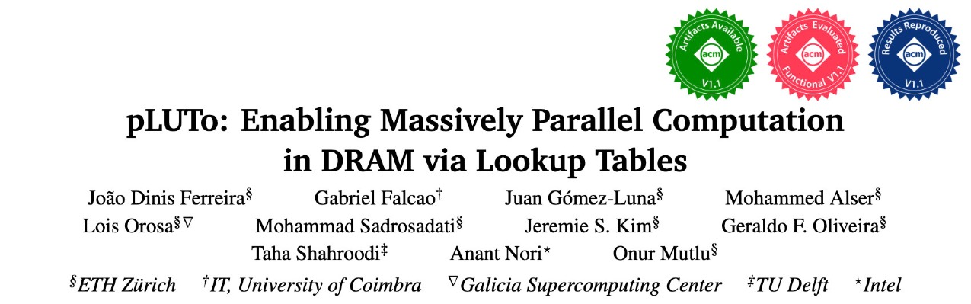

More in the Paper
https://arxiv.org/pdf/2104.07699.pdf

Slide 73
Contents
Introduction
pLUTo
Overview
pLUTo Designs
System Integration
Evaluation
Conclusion

Slide 74

Methodology: Experimental Setup
Baselines
CPU (Intel® Xeon Gold 5118)
GPU (NVIDIA® GeForce RTX 3080 Ti)
Processing-near-Memory (PnM)
pLUTo
In-house simulator, open-sourced
https://github.com/CMU-SAFARI/pLUTo
We evaluate:
Performance
Energy consumption
Area overhead
Circuit-level reliability and correctness
…

Slide 75
Methodology: Experimental Setup
Baselines
CPU (Intel® Xeon Gold 5118)
GPU (NVIDIA® GeForce RTX 3080 Ti)
Processing-near-Memory (PnM)
pLUTo
In-house simulator, open-sourced
https://github.com/CMU-SAFARI/pLUTo
We evaluate:
Performance
Energy consumption
Area overhead
Circuit-level reliability and correctness
…

Slide 76
Methodology: Workloads
7 real-world workloads (not well supported by prior work)
CRC-8/16/32
Salsa20
VMPC
Image Binarization
Color Grading
4 synthetic workloads (supported by prior work)
Vector Addition
Vector Point-Wise Multiplication
Row-Level Bitwise Logic Operations
Bit Counting

Slide 77
Performance
Average speedup across 7 real-world workloads
pLUTo significantly outperforms CPU, GPU and PnM baselines

Slide 78
Performance (normalized to area)
Average speedup normalized to area across 7 real-world workloads
pLUTo provides substantially higher performance per unit area than both the CPU and the GPU

Slide 79
Energy Consumption
Average energy consumption across 7 real-world workloads
pLUTo significantly reduces energy consumption compared to processor-centric architectures for various workloads

Slide 80
More Results in the Paper
Comparison with FPGA
Area Overhead Analysis
Circuit-Level Reliability & Correctness
Subarray-Level Parallelism
LUT Loading Overhead
Range of Supported Operations

Slide 81
Contents
Introduction
pLUTo
Overview
pLUTo Designs
System Integration
Evaluation
Conclusion

Slide 82

pLUTo Summary
The pLUTo Lookup Table Query introduces support for the execution of arbitrarily complex operations in DRAM

Slide 83

pLUTo Summary
The pLUTo Lookup Table Query introduces support for the execution of arbitrarily complex operations in DRAM
Buffered Sense Amplifier, Gated Sense Amplifier & Gated Memory Cell target different performance/energy/area tradeoffs

Slide 84


pLUTo Summary
The pLUTo Lookup Table Query introduces support for the execution of arbitrarily complex operations in DRAM
Buffered Sense Amplifier, Gated Sense Amplifier & Gated Memory Cell target different performance/energy/area tradeoffs
pLUTo API, pLUTo Compiler & pLUTo Controller
facilitate programmer adoption of pLUTo

Slide 85

pLUTo Summary
The pLUTo Lookup Table Query introduces support for the execution of arbitrarily complex operations in DRAM
Buffered Sense Amplifier, Gated Sense Amplifier & Gated Memory Cell target different performance/energy/area tradeoffs
pLUTo API, pLUTo Compiler & pLUTo Controller
facilitate programmer adoption of pLUTo
pLUTo greatly outperforms the CPU/GPU/PnM baselines in performance and energy while incurring small area overheads

Slide 86
pLUTo
Enabling Massively Parallel Computation in DRAM via Lookup Tables
João Dinis Ferreira |  | Gabriel Falcao |  | Juan Gómez-Luna |  | Mohammed Alser
Lois Orosa |  | Mohammad Sadrosadati |  | Jeremie S. Kim |  | Geraldo F. Oliveira
Taha Shahroodi |  | Anant Nori |  | Onur Mutlu

Slide 87
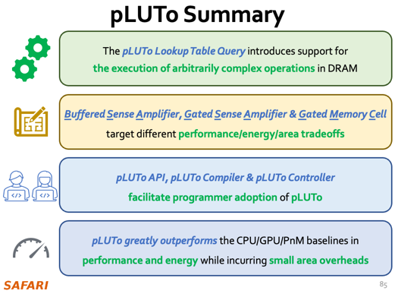
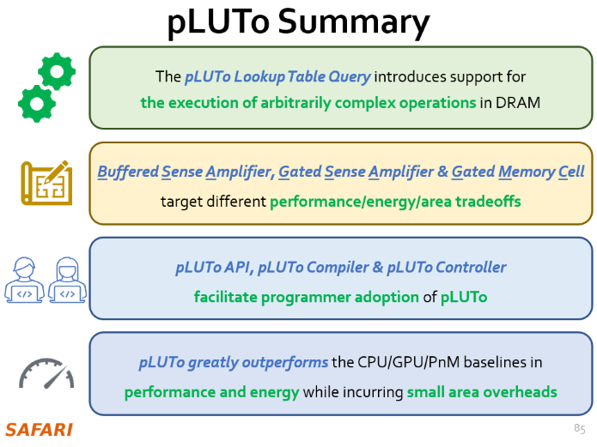
pLUTo
Enabling Massively Parallel Computation in DRAM via Lookup Tables
arXiv
GitHub

Slide 88
pLUTo
Enabling Massively Parallel Computation in DRAM via Lookup Tables
João Dinis Ferreira |  | Gabriel Falcao |  | Juan Gómez-Luna |  | Mohammed Alser
Lois Orosa |  | Mohammad Sadrosadati |  | Jeremie S. Kim |  | Geraldo F. Oliveira
Taha Shahroodi |  | Anant Nori |  | Onur Mutlu

Slide 89
Backup Slides

Slide 90
DRAM Organization

Slide 91
pLUTo Components

Slide 92
pLUTo Example Operation

Slide 93
pLUTo Cell Designs

Slide 94
System Integration: End-to-End

Slide 95
Speedup

Slide 96
Speedup Normalized to Unit Area

Slide 97
Energy, Normalized

Slide 98
Speedup Over FPGA

Slide 99
Fraction of Time Spent Loading LUTs (DDR4, SSD) vs. Volume of Queried Data (MB)

Slide 100
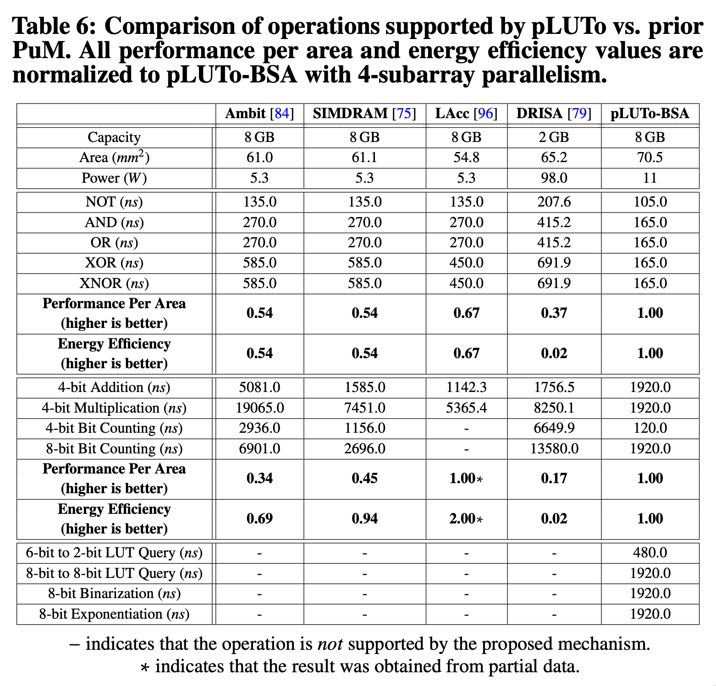
Comparison of Operations Supported by pLUTo vs. Prior Work

Slide 101
Energy Efficiency (pLUTo vs. PuM vs. PnM) vs. Bit Width, one operation

Slide 102
Throughput & Energy Consumption of pLUTo vs. LUT Query Size

Slide 103
Speedup vs. Subarray-Level Parallelism

Slide 104
Circuit-Level Reliability and Correctness

Slide 105
Impact of tFAW

Slide 106
QR Codes
arXiv
GitHub

Slide 107
The pLUTo LUT Query: Backup
1 | 0 | 1 | 3
?
?
?
?
✓
0
2 | 2 | 2 | 2
3 | 3 | 3 | 3
5 | 5 | 5 | 5
7 | 7 | 7 | 7
- | - | - | -
- | - | - | -

Slide 108
Banner Template
The quick brown fox jumps over the lazy dog

